Slide 1
CHAPTER 6:
Information Visualization
Designing the User Interface:
Strategies for Effective Human-Computer Interaction
Fifth Edition
Ben Shneiderman & Catherine Plaisant
in collaboration with
Maxine S. Cohen and Steven M. Jacobs

Slide 2
Information Visualization
“A Picture is worth a thousand words”
Introduction
Data Type by Task Taxonomy
Challenges for Information Visualization
14-<number>

Slide 3
Introduction
Information visualization can be defined as the use of interactive visual representations of abstract data to amplify cognition
Information visualization provides compact graphical presentations and user interfaces for interactively manipulating large numbers of items, possibly extracted from far larger datasets.
The abstract characteristic of the data is what distinguishes information visualization from scientific visualization.
  Information visualization: categorical variables and the discovery of patterns, trends, clusters, outliers, and gaps
  Scientific visualization: continuous variables, volumes and surfaces
14-<number>

Slide 4
Introduction
Sometimes called visual data mining, it uses the enormous visual bandwidth and the remarkable human perceptual system to enable users to make discoveries, make decisions, or propose explanations about patterns, groups of items, or individual items.
Visual-information-seeking mantra:
  Overview first, zoom and filter, then details on demand.
  Overview first, zoom and filter, then details on demand.
  Overview first, zoom and filter, then details on demand.
14-<number>

Slide 5
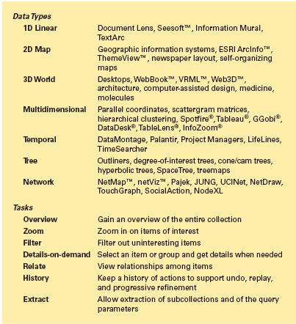
Data Type by Task Taxonomy
7
7
14-<number>

Slide 6
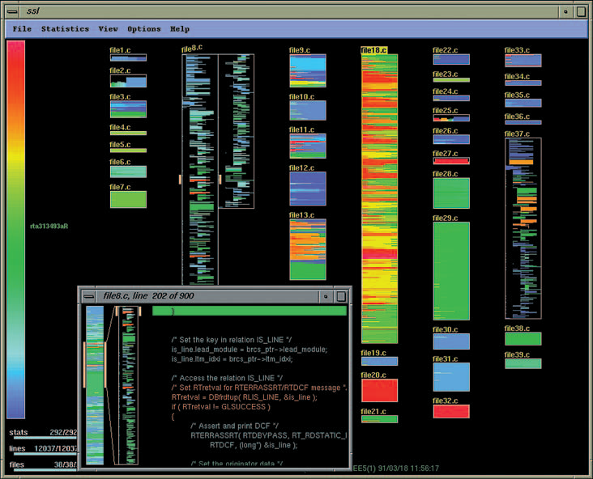
Data Type: 1D Linear Data
source code
text
dictionaries
lists
show attributes of items
(Showing age of code)
14-<number>

Slide 7
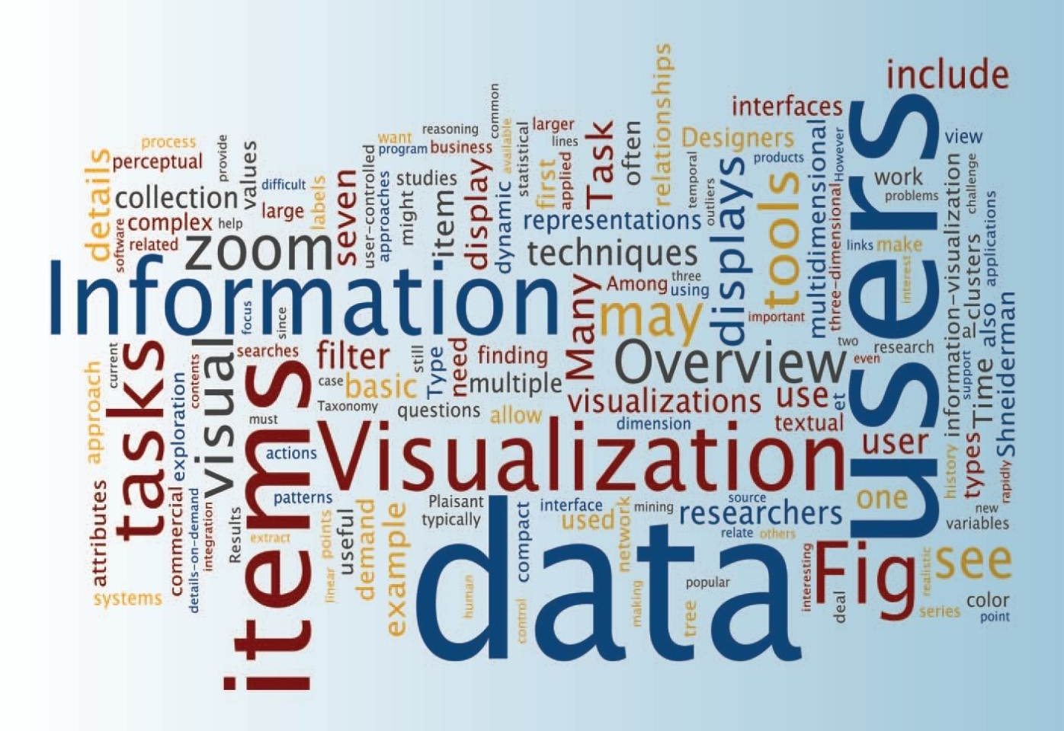
Data Type : 1D Linear Data
http://www.wordle.net/
(Most frequent words are larger - Wordle)
14-<number>

Slide 8
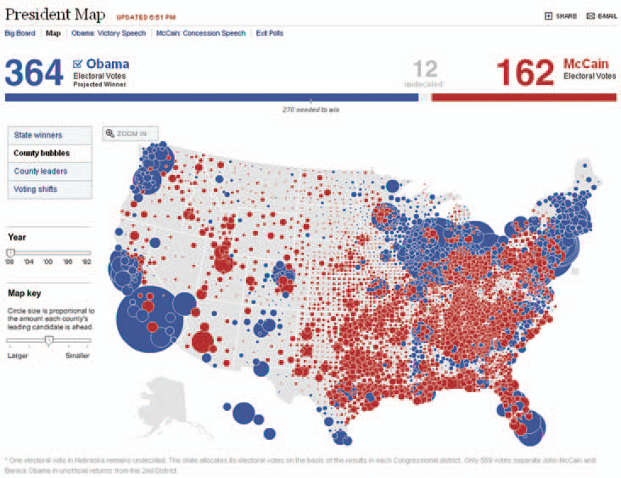
Data Type: 2D Map Data
Planar data
maps
floor plans
news layouts
may or may not be rectangular
find adjacent items, regions, paths
perform 7 basic tasks
14-<number>

Slide 9
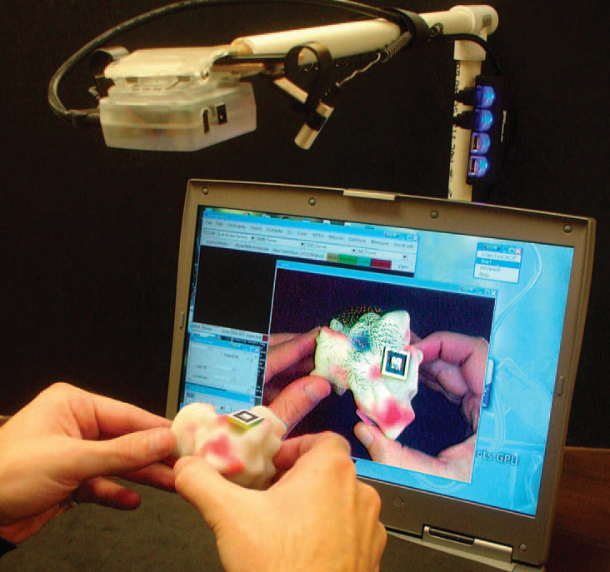
Data Type: 3D World Data
Real world objects
3D relationships
Must cope with orientation when viewing
Uses: medical imaging, architectural walkthroughs
14-<number>

Slide 10
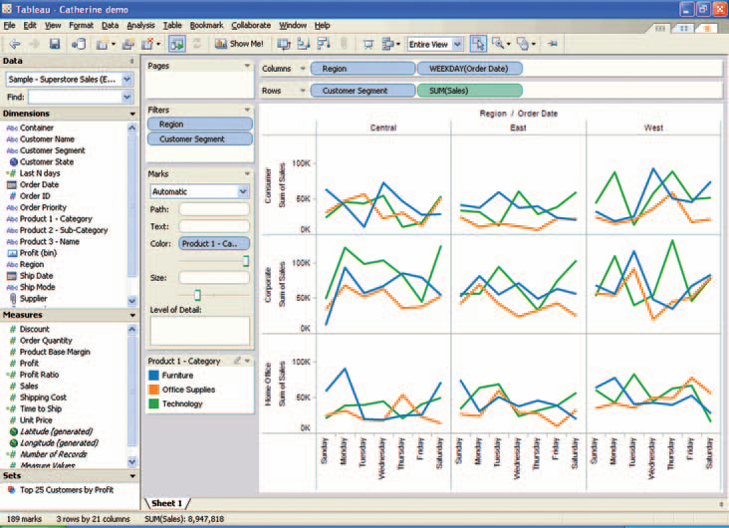
Data Type: Multidimensional Data
Items with n attributes
EEG brain waves
(freq x time x channel)
Usually looking for patterns
Sales for 3 regions and 3 customer segments over time
14-<number>

Slide 11
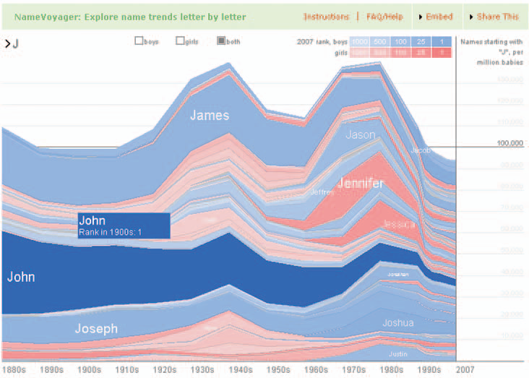
Data Type: Temporal Data
http://www.babynamewizard.com/voyager/
Time Series Data
EKGs,
Stock Market
Weather
Have start/end times
items may overlap
compare periodical data
(Trends in baby names starting with J )
14-<number>

Slide 12
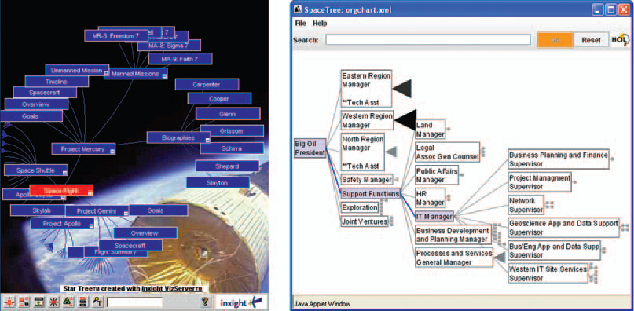
Data Type: Tree Data
(Two representations of same data)
Hyperbolic tree Tree
Animated
Branches smaller in periphery
Icon shows branches that cannot
be displayed (by size)
14-<number>

Slide 13
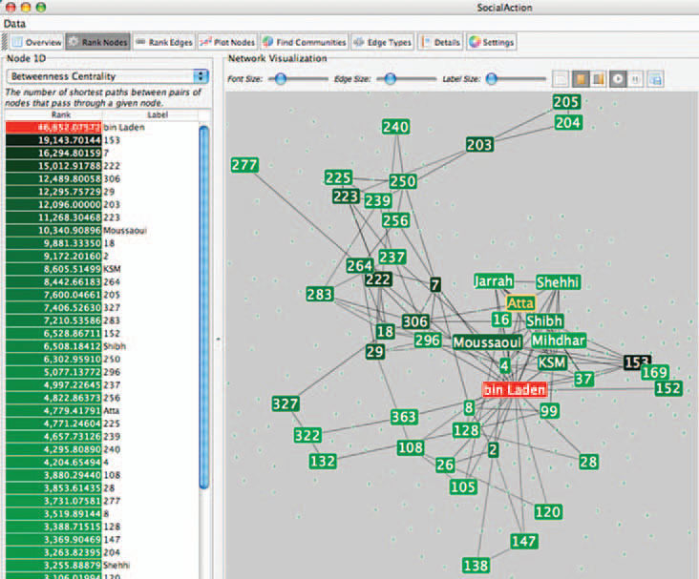
Data Type: Network Data
Answers questions about paths
view complex relationships, such as social networks of terrorists
14-<number>

Slide 14
The seven basic tasks
Overview task - users can gain an overview of the entire collection
Zoom task - users can zoom in on items of interest
Filter task - users can filter out uninteresting items
Details-on-demand task - users can select an item or group to get details
Relate task - users can relate items or groups within the collection
History task - users can keep a history of actions to support undo, replay, and progressive refinement
Extract task - users can allow extraction of sub-collections and of the query parameters
14-<number>

Slide 15
The seven basic tasks
1D Linear
2D Map
3D World
Multi-Dim
Temporal
Tree
Network
Overview task
Zoom
Filter task
Details-on-demand task
Relate task
History task
Extract task
14-<number>

Slide 16
Challenges for Information Visualization
Importing and cleaning data : preprocessing
Combining visual representations with textual labels
Finding related information (and integrating it)
Viewing large volumes of data
Integrating data mining (letting statistical analysis see subtle trends)
Integrating with analytical reasoning techniques
Collaborating with others
Achieving universal usability with visualization tools
Evaluation
14-<number>

Slide 17
Summary
Information visualization
  labs→ commercial applications
New tools available – need to be integrated smoothly with exiting software
Need to support full task list
Need to present information rapidly and allow user-controlled exploration
Need advanced data structures, high-resolution color displays, fast data retrieval, and novel ways to train users
Careful testing to ensure they actually help users perform tasks.
14-<number>

